Slide 1
Linux fundamental
Presenter: Trinh Cao Cuong
4/2024

Slide 2
Table of contents
1. process
2. Threads
3. Signals
4. Virtual memory
5. ipc

Slide 3
1.
PROCESS

Slide 4
What’s process
A process is an instance of an executing program.
From the kernel’s point of view, a process consists of:
User-space memory containing program code and variables used by that code
A range of kernel data structures that maintain information about the state of the process includes:
+ Various identifier numbers (IDs) associated with the process
+ Virtual memory tables
+ The table of open file descriptors
+ Information relating to signal delivery and handling
+ Process resource usages and limits
+ The current working directory
+ A host of other information.

Slide 5
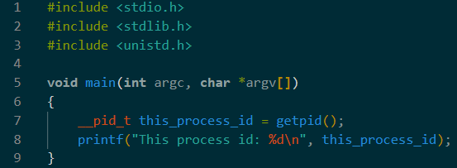
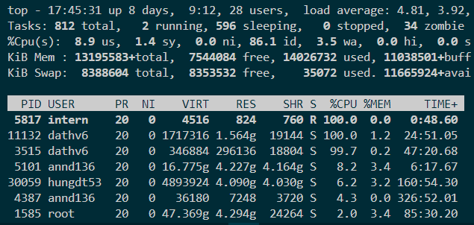
Process Identify
PID: Process ID - a positive integer that uniquely identifies the process on the system
init process (PID = 1) : can not be kill
Limits process ID < 32768 (can adjust in /proc/sys/kernel/pid_max)

Slide 6
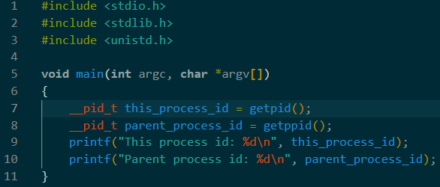
Parent Process identify
Each process has a parent—the process that created it.
A process can find out the process ID of its parent using the getppid() system call

Slide 7
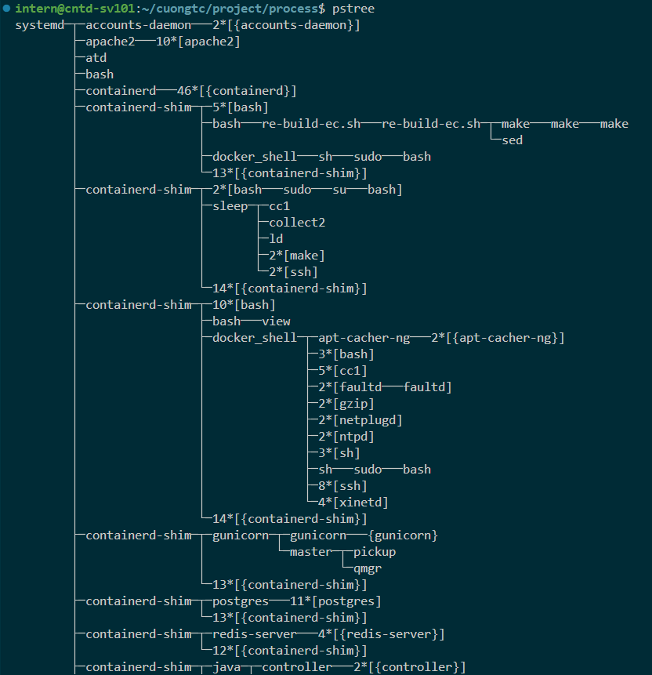
Parent Process vs process
Each process has only one parent and many child.
Init process has PID = 1 and PPID = 0
pstree: print process tree command

Slide 8
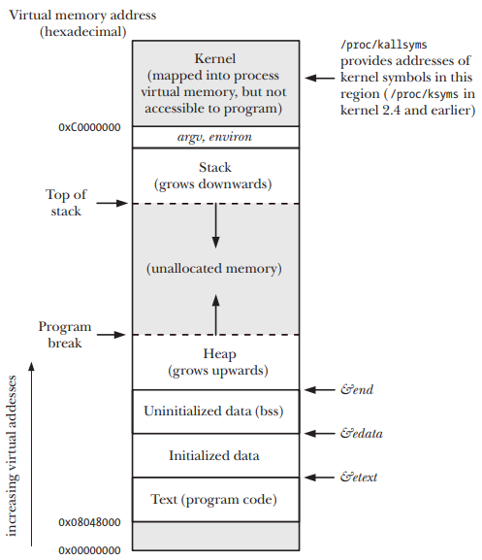
Processes: MEMory layout
The memory allocated to each process is composed of a number of parts, usually referred to as segments:
Text segment: Read-only, Shared between process
Initialized data segment: Global and static variable that are explicitly initialized
Uninitialized data segment (BSS): Not initialized data
Stack: Dynamically growing and shrinking segment containing stack frames
Heap: Dynamically memory allocated at run time

Slide 9
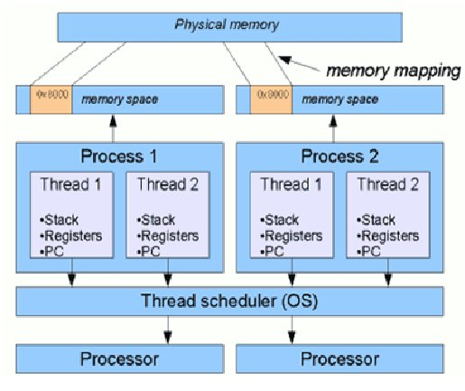
Processes: MEMory layout
Each process has it own virtual memory space, pointer, register and stack

Slide 10
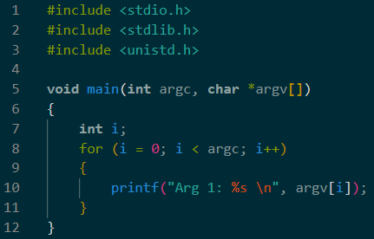
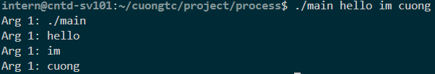
command line argument – argc, argv, env
/
proc/
[pid]/
cmdline
:command argument of process

Slide 11
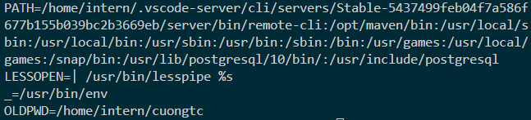
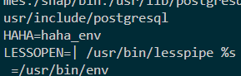
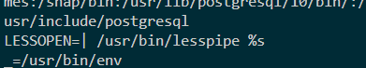
Process environment
Each process has list of environment variable.
When process created, it inherits a copy of its parent’s environment.
Show environment:
Set/Unset env:
/
proc/
[pid]/
cmdline
:command argument of process

Slide 12
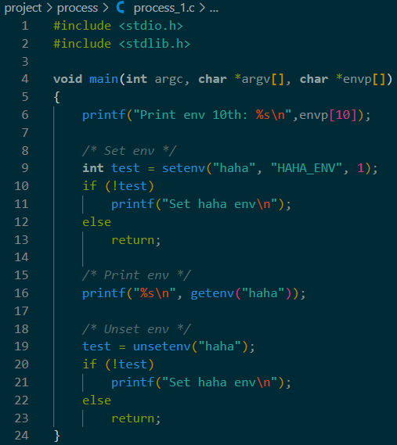
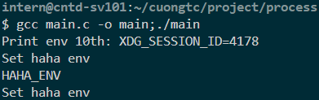
command line argument – argc, argv, env

Slide 13
PROCESS credential

Slide 14
Process credentials
Each process has a set of UIDs and GIDs (maybe refer to process credentials):
Real user ID and group ID
Effective user ID and group ID (UNIX common but Linux)
File-system user ID and group ID (Linux-specific) (same as effective)
Saved set-user-ID and saved set-group-ID
Supplementary group IDs

Slide 15
Process credentials: Real User ID and Real Group ID
The real user ID and group ID identify the user and group to which the process belongs.
When login, login shell gets its real user and group IDs.
When a new process is created (e.g., when the shell executes a program), it inherits these identifiers from its parent.
Init process
Login
Real user
/etc/passwd
New process created
inherit
…….

Slide 16
Process credentials: File-system user ID and group ID
On Linux, it is the file-system user and group IDs determine permissions when performing file-system operations such as:
Opening files
Changing file ownership
Modifying file permissions

Slide 17
Process credentials: Saved Set-User-ID and Saved Set-Group-ID
When program is executed:
If the set-user-ID (set-group-ID) permission bit is enabled on the executable, then the effective user (group) ID of the process is made the same as the owner of the executable.
If the set-user-ID (set-group-ID) bit is not set, then no change is made to the effective user (group) ID of the process.
The values for the saved set-user-ID and saved set-group-ID are copied from the corresponding effective IDs. This copying occurs regardless of whether the set-user-ID or set-group-ID bit is set on the file being executed

Slide 18
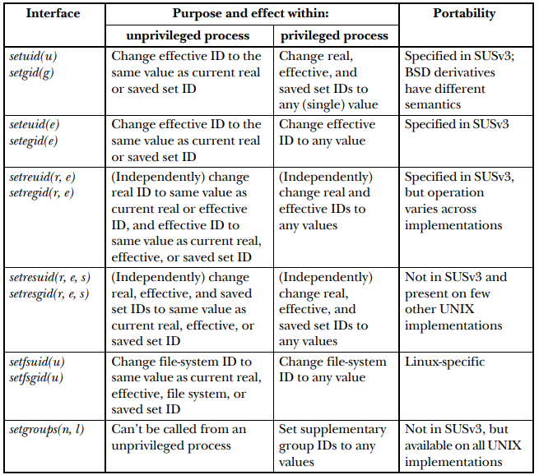
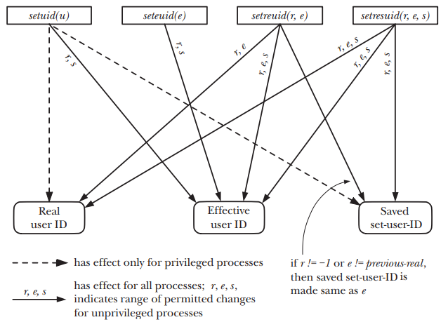
Process credentials Interface

Slide 19
PROCESS infomation

Slide 20
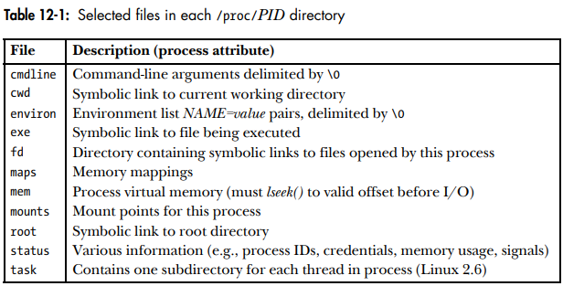
Process information
Process information provide in /proc/PID

Slide 21
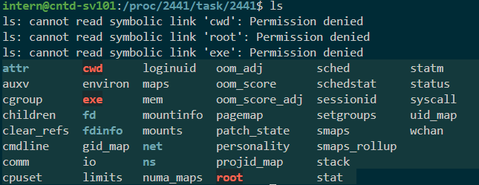
Process information
Thread of each process information provide in /proc/PID/task/TID
(TID: Thread ID)

Slide 22
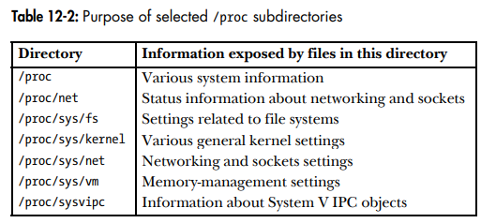
Process information
Various files and subdirectories under /proc provide access to system-wide information

Slide 23
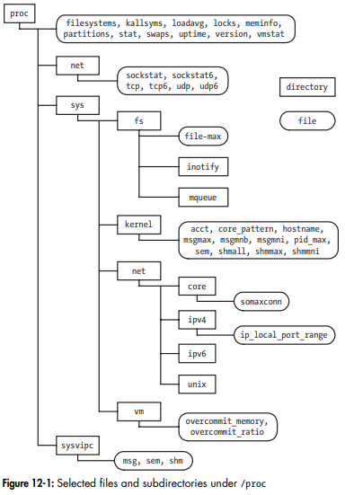
Process information

Slide 24
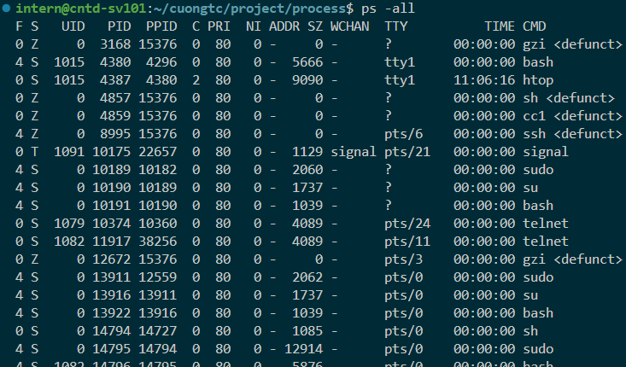
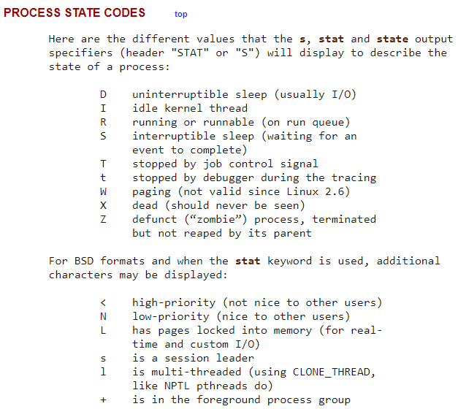
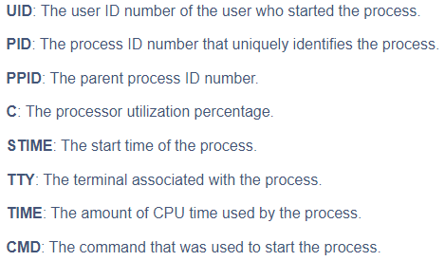
Process state
ps –all : print all process info

Slide 25
PROCESS creation

Slide 26
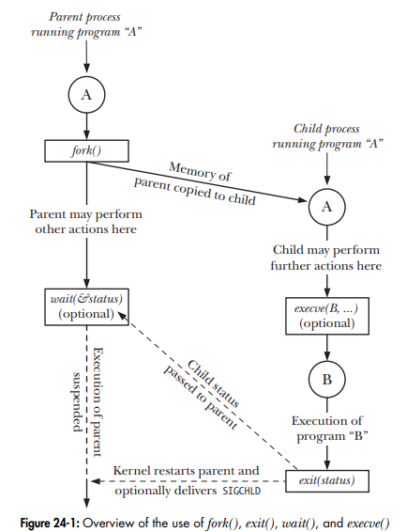
Overview of fork(), exit(), wait(), and execve()
folk() : allow parent process to create new child process (almost exact duplicate of the parent)
exit(status) : terminate a process, free all resource and return status to parent (using wait)
wait(&status) : suspend current process until its child process return status
execve(pathname, argv, envp) : execute new program (load new program to process’s memory, the existing program is discarded)

Slide 27
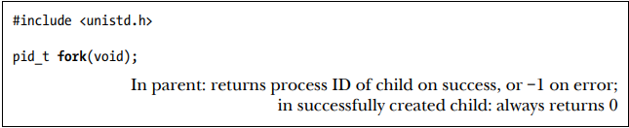
Create new process : fork()
fork() : create new child process, which is an almost exact duplicate of the calling process (parent process)
Notice: in each process, execution continues from the point where fork() returns

Slide 28
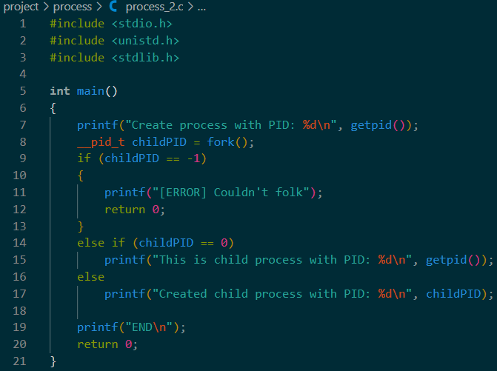
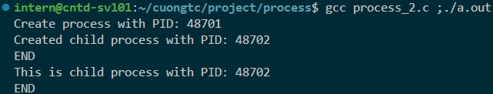
Create new process : fork()

Slide 29
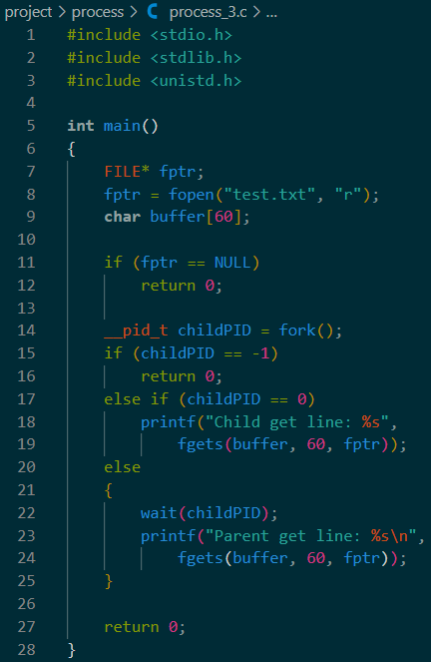
Create new process : file sharing
Attributes of an open file are shared between the parent and child.
For example, if the child updates the file offset, this change is visible through the corresponding descriptor in the parent

Slide 30
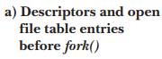
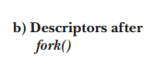
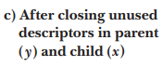
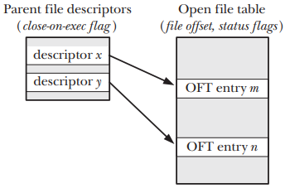
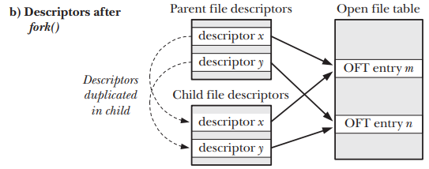
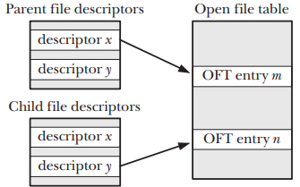
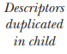
Create new process : file sharing
If file sharing is not required, after a fork(), the parent and child should use different file descriptors

Slide 31
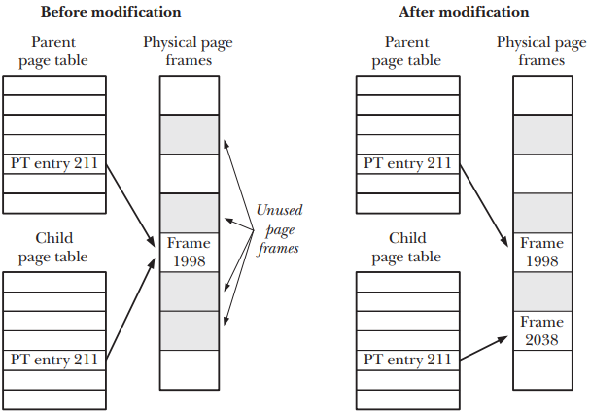
Create new process : memory semantics of fork()
fork() use two techniques to avoid such wasteful copying:
Marks the text segment of each process as read-only, the parent and child can share the same text segment
For the pages in the data, heap, and stack segments of the parent process, the kernel use copy-on-write (make a copy when modify variable)

Slide 32
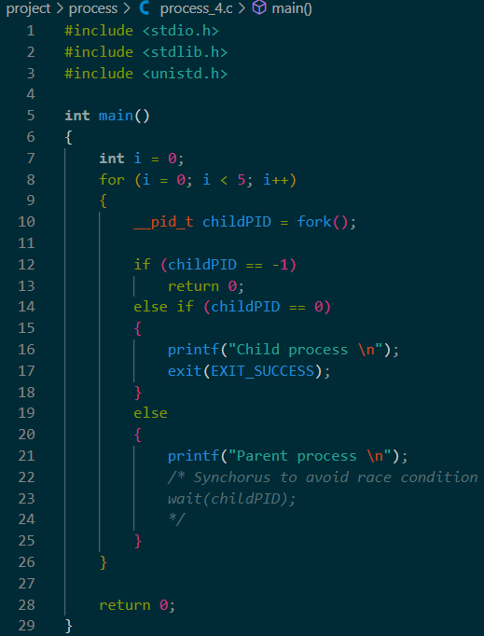
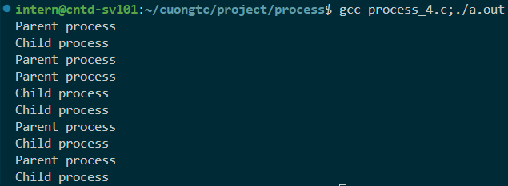
Create new process : Race conditions after fork()
After created process, 99.7% parent process will running first but 0.03% child process will running first (Race condition)
Don’t know which process is running first

Slide 33
Process termination

Slide 34
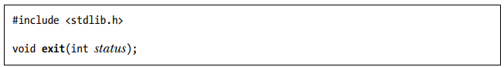
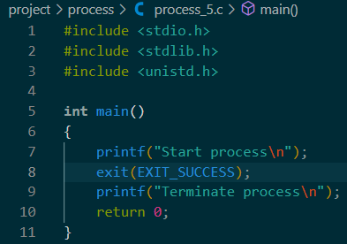

Termination process : exit()
A process may terminate in two general ways:
Abnormal: by a signal whose default action is to terminate the process (with or without a core dump)
Normally: using the _exit() system call.

Slide 35
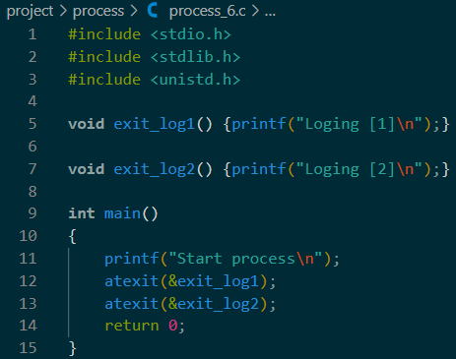
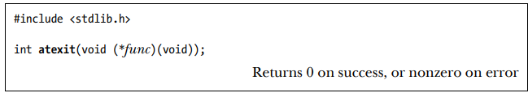
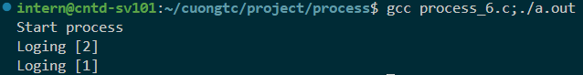
Termination process : exit handlers
Registering exit handlers to perform some actions before terminate process.
atexit() : register handler, the handler called in reverse order of registration

Slide 36
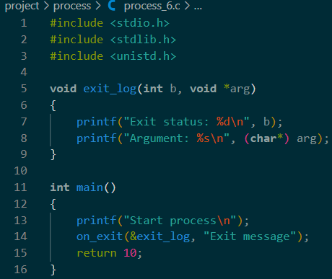
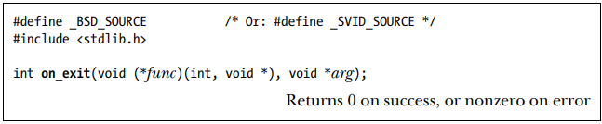
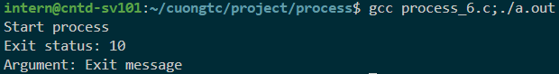
Termination process : exit handlers
Registering exit handlers to perform some actions before terminate process
on_exit() : nonstandard method but can register handler with arguments

Slide 37
Termination process : flow
Termination process occur (1):
Open file descriptors, directory streams, message catalog descriptors, and conversion descriptors are closed.
As a consequence of closing file descriptors, any file locks held by this process are released.
Any attached System V shared memory segments are detached, and the shm_nattch counter corresponding to each segment is decremented by one.
For each System V semaphore for which a semadj value has been set by the process, that semadj value is added to the semaphore value.
If this is the controlling process for a controlling terminal, then the SIGHUP signal is sent to each process in the controlling terminal’s foreground process group, and the terminal is disassociated from the session.
…

Slide 38
Termination process : flow
Termination process occur (2):
…
Any POSIX named semaphores that are open in the calling process are closed as though sem_close() were called.
Any POSIX message queues that are open in the calling process are closed as though mq_close() were called.
If, as a consequence of this process exiting, a process group becomes orphaned and there are any stopped processes in that group, then all processes in the group are sent a SIGHUP signal followed by a SIGCONT signal.
Any memory locks established by this process using mlock() or mlockall() are removed.
Any memory mappings established by this process using mmap() are unmapped.

Slide 39
Monitor child process

Slide 40
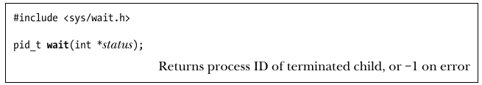
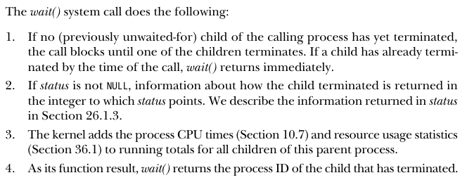
Monitor child process
Where a parent creates child processes, it is useful for the parent to be able to monitor the children to find out when and how they terminate.

Slide 41
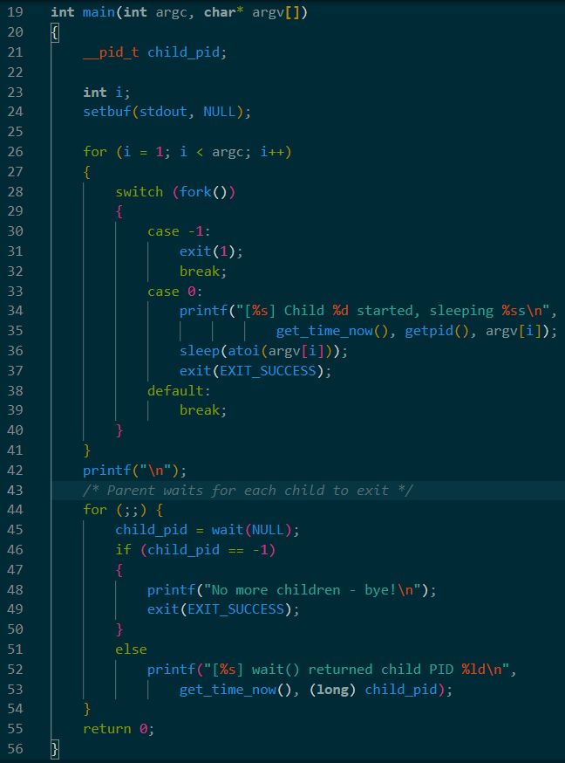
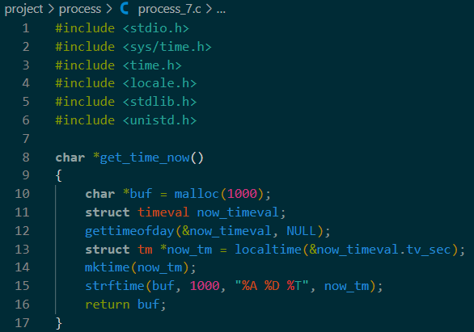
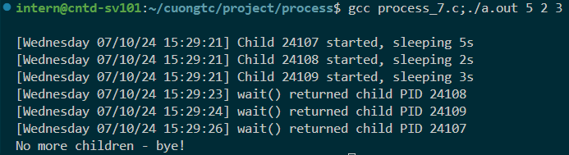
Monitor child process

Slide 42


Monitor child process
Where a parent creates child processes, it is useful for the parent to be able to monitor the children to find out when and how they terminate.

Slide 43
Monitor child process : Orphan and zombie
Lifetimes of parent and child processes are usually not the same:
If parent die before child, child process become orphan process
If child die before parent wait(), child become zombie process
Orphan process:
The orphaned child is adopted by init process (PID is 1).

Slide 44

Monitor child process : Orphan and zombie
Zombie process:
The child process has finished its work, the parent should still be permitted to perform a wait() to determine how the child terminated at some later time
So, the kernel turn child into Zombie state:
Most of the resources held by the child are released back to the system to be reused by other processes
The only part is is an entry in the kernel’s process table recording : the child’s process ID, termination status, and resource usage statistics

Slide 45
Program execution

Slide 46

Program execution
A process can use the execve() system call to replace the program that it is running by a completely new program.

Slide 47





Program execution
Method: Error code:

Slide 48


Executing a Shell Command: system()
The system() function:
Allows the calling program to execute an arbitrary shell command by creates a child process that invokes a shell to execute command.

Slide 49
group, session, job control

Slide 50

group, session, job control : overview
Process groups and sessions form a two-level hierarchical relationship between processes:
A process group is a collection of related processes
A session is a collection of related process groups

Slide 51
group, session, job control : process group
A process group is a set of one or more processes sharing the same process group identifier (PGID) :
A process group has a process group leader (Which create the group and its PID become PGID)
A new process inherits its parent’s process group ID.
A process group has a lifetime: from leader create group to last process leave
A process may leave a process group either by terminating or by joining other group
Process group leader need not be a last member of group

Slide 52


Process group
Process group function:

Slide 53
group, session, job control : process session
Define:
A session is a collection of process groups.
Session Identify (SID):
A process’s session membership is determined by its session identifier (SID).
A session leader is the process that creates a new session and whose process ID becomes the session ID.
A new process inherits its parent’s session ID.
Controlling terminal:
All of the processes in a session share a single controlling terminal established when the session leader first opens a terminal device.
A terminal may be the controlling terminal of at most one session.

Slide 54



sessions
Session function:
Controlling terminal:

Slide 55
group, session, job control : process session
Process groups in a session:
Foreground process group:
- Only process in this group can read input from controlling terminal
- Signal-generating on the controlling terminal sent to all members of the foreground process group. (SIGQUIT, SIGINT, SIGTSTP, …)
Background process group
When establishing the connection to the controlling terminal, the session leader become the controlling process (to send SIGHUP signal is disconnect)

Slide 56


group, session, job control : EXAMPLE

Slide 57

Foreground and Background Process Groups
Foreground and Background Process Groups function:

Slide 58



job control
Jobs refer to processes that are running in the background or foreground.
Job control refers to the ability to manipulate these processes, including suspending, resuming, and terminating them.
To run process in background use “&” at the end of command.
Sleep at foreground will block terminal:
Sleep at background won’t block terminal:
Move between foreground and background:
(Continue block terminal)

Slide 59
PRIORITIES AND SCHEDULING

Slide 60
PRIORITIES AND SCHEDULING
Using round-robin time-sharing model to scheduling processes for use CPU
Each process in turn is permitted to use the CPU for a brief period of time (time slice / quantum)
Round-robin time-sharing satisfies two important require ments of an interactive multitasking system:
Fairness: Each process gets a share of the CPU.
Responsiveness: A process doesn’t need to wait for long periods before it receives use of the CPU
Process can’t exercise direct control over when and how long they will be able to use CPU

Slide 61


PRIORITIES AND SCHEDULING
A process can indirectly influence to kernel’s scheduling algorithm by nice value:
A process with higher nice value will get more time to use CPU
A process with low nice value won’t be complete starved by CPU
We can set priority by :

Slide 62



PRIORITIES AND SCHEDULING : Realtime scheduling
A realtime application must provide a guaranteed maximum response time for external inputs so:
A high-priority process should be able to maintain exclusive access to the CPU until it completes or voluntarily relinquishes the CPU
A realtime application should be able to control the precise order in which its component processes are scheduled
“Realtime Priority Ranges” : “Scheduler modify” :

Slide 63
Process resources

Slide 64



Process resources
A process has 2³² bytes = 4 Gb data (32-bits)
Process usage resource:
We can set that limit by:

Slide 65
Daemon Process

Slide 66
Daemon process
A daemon is a process with:
Long-lived: Often, a daemon is created at system startup and runs until the system is shut down.
Runs in the background and has no controlling terminal: The lack of a controlling terminal ensures that the kernel never automatically generates any job-control or terminal-related signals (such as SIGINT, SIGTSTP, and SIGHUP) for a daemon.

Slide 67
Daemon process: create a daemon
To be come daemon, a program performs the following steps:
fork() and let parent exit: Create child process and exit parent (daemon process is child of init)
+ Leave daemon process running in the background
+ Confirm child process is not to be process leader
Create new session - setsid() : Start a new session and free itself of any association with a controlling terminal.
If the daemon might later open a terminal device, then we must take steps to ensure that the device does not become the controlling terminal (step 1 again)
Set permission : Clear the process umask to ensure when the daemon creates files and directories, they have the requested permissions.

Slide 68
Daemon process: create a daemon
5. Change the process’s current working directory (typically to the root /).
This is necessary because a daemon usually runs until system shutdown; if the daemon’s current working directory is on a file system other than the one containing /, then that file system can’t be unmounted
6. Close all open file descriptors inherited from its parent. (optional)
7. Opens /dev/null and uses dup2() (or similar) to make all those descriptors refer to this device. (optional)

Slide 69





Daemon process: system log
When writing a daemon, one problem we encounter is how to display error messages. The syslog facility was devised to address this problem.

Slide 70


Daemon process : create a daemon
Example:

Slide 71
Bash command

Slide 72
Bash command
To manage process on Linux system, we can using command from terminal:
Command | Description
bg | To send a process to the background
& | Running a process in background
fg | To run a stopped process in the foreground
top | Display Linux process in realtime view
ps | Displays information about a selection of the active processes. If you want a repetitive update of the selection and the displayed information, use top(1) instead.
pgrep | Find the process by name
pidof | Gives the Process ID (PID) of a process
kill | Send signal to a process
nice | Starts a process with a given priority
renice | Changes priority of an already running process
df | Gives free hard disk space on your system
free | Gives free RAM on your system

Slide 73
Bash command
Some reference command:
Command | Description
umask | Set permission file IO
grep | Search

Slide 74
2.
Posix Threads

Slide 75

Threads : Definition
Like processes, threads are a mechanism to perform multiple tasks concurrently.
Why we need multi thread ?
Speed up program and use CPU more efficiency
Don’t need to wait time between independently code (eg: Allow CPU run multi task)

Slide 76


Threads : Definition
A single process can contain multiple threads:
These threads are independently executing the same program
Main thread is start when process start up
Threads share the same global memory (initialized data, uninitialized data, and heap segments)
Threads in a process can execute concurrently. If one thread is blocked on I/O, other threads are still eligible to execute

Slide 77

Threads : posix api - pthread api
POSIX (Portable Operating System Interface) is a family of standards specified by the IEEE Computer Society.
POSIX Thread provide Pthread API to manage thread in C/C++
Pthread data type:
In particular, we can’t compare
variables of these types using the C
“==“ operator.

Slide 78
Threads : compiling
On Linux, programs that use the Pthreads API must be compiled with the
–pthread option.
The effects of this option include the following:
The _REENTRANT preprocessor macro is defined. This causes the declarations of a few reentrant functions to be exposed.
The program is linked with the libpthread library (the equivalent of –lpthread).

Slide 79



Threads : creation
When a program is started, the resulting process consists of a single thread,
called the initial or main thread
Using pthread_create() to create a new thread:
thread: unique identifier for this thread (TID)
attr: thread attribute
start: function first call in this thread
arg: argument for start
Warning: avoid race condition after creation!

Slide 80


Threads : Thread ID (TID)
Each thread within a process is uniquely identified by a thread ID (TID):
To identify the thread (using in function like pthread_join,…)
Useful to tag dynamic data structures with the ID of a particular thread
This ID is returned to the caller of pthread_create(), and a thread can obtain its own ID using pthread_self().
Because pthread_t is conldn’t use “==” to compare, so pthread_equal() function allows us check whether two thread IDs are the same.

Slide 81

Threads : termination
The execution of a thread terminates in one of the following ways:
The thread’s start function return value for the thread.
The thread calls pthread_exit()
The thread is canceled using pthread_cancel()
Any of the threads calls exit() (all threads in the process terminate immediately)
The main thread return (all threads in the process terminate immediately)

Slide 82

Threads : join
The pthread_join() function:
Waits for the thread identified by thread to terminate.
If that thread has already terminated, pthread_join() returns immediately.
If a thread is not detached, we must join with it using pthread_join().
Else, when the thread terminates, it produces the thread equivalent of a zombie process.
Aside from wasting system resources, if enough thread zombies accumulate, we won’t be able to create addi tional threads.

Slide 83
Threads : join
Threads are peers : Any thread in a process can use pthread_join() to join with any other thread in the process.
For example, if thread A creates thread B, which creates thread C, then it is possible for thread A to join with thread C, or vice versa.

Slide 84

Threads : detaching
To automatically clean up and remove the thread when it terminates:
Mark the thread as detached by using pthread_detach() specifying the thread’s identifier in thread.
Once a thread has been detached, it is no longer possible to use pthread_join() and the thread can’t be made joinable again.
Detaching a thread doesn’t make it immune to a call to exit() in another thread or a return in the main thread.

Slide 85


Threads : attributes
Link: https://www.ibm.com/docs/ro/zos/2.4.0?topic=functions-pthread-attr-init-initialize-thread-attribute-object

Slide 86


Slide 87
Thread synchronization

Slide 88
Thread synchronization
Thread can easily share resource but it comes at a cost! And thread need synch (async need sync)
Threads can use to synchronize their actions:
Mutexes : allow threads to synchronize their use of a shared resource, for example, one thread doesn’t try to access a shared variable at the same time as another thread is modifying it.
Condition variables : allow threads to inform each other that a shared variable (or other shared resource) has changed state.

Slide 89
Mutexes
To avoid the problems that can occur when threads try to update a shared variable, we must use a mutex (short for mutual exclusion) to ensure that only one thread at a time can access the variable.
Mutexes can be used to ensure atomic access to any shared resource.

Slide 90

Mutexes
A mutex:
Has two states: locked and unlocked.
At any moment, at most one thread may hold the lock on a mutex.
Attempting to lock a mutex that is already locked either blocks or fails with an error, depending on the method used to place the lock.
When a thread locks a mutex, it becomes the owner of that mutex. Only the mutex owner can unlock the mutex.

Slide 91


Mutexes : init, destroy
Statically allocated mutexes:
Dynamically initializing a mutex:
Destroy a mutex:

Slide 92

Mutexes : lock and unlock
Locking and unlocking a mutex:
This pthread_mutex_lock() locks the mutex and returns immediately:
If the mutex is currently locked by another thread, pthread_mutex_lock() blocks until the mutex is unlocked

Slide 93



Mutexes : demo – without mutex

Slide 94



Mutexes : demo – with mutex

Slide 95


Mutexes : demo – why join?

Slide 96


Condition variable
A mutex prevents multiple threads from accessing a shared variable at the same time.
A condition variable allows one thread to inform other threads about changes in the state of a shared variable (or other shared resource) and allows the other threads to wait (block) for such notification.

Slide 97


Condition variable

Slide 98
Thread Safety
Thread local storage

Slide 99
Thread cancel

Slide 100
3.
IPC overview

Slide 101

IPC overview
Processes and threads need IPC method to communicate with one another and to synchronize their actions.
IPC method categories:
Communication: exchanging data between processes.
Synchronization: synchronizing the actions of processes or threads.
Signals: can be used as a synchronization technique in certain circumstances
Other: Dbus (newly for Linux driver as Wifi or Bluetooth communication)

Slide 102

IPC overview - communication
Communication: allow processes to exchange data with one another. (maybe threads, seldomly).
We can break the communication facilities into two categories:
Data-transfer facilities: Require 2 data transfer – write to Kernel space and read from Kernel space
Shared memory: allows processes to exchange information by placing it in a region of memory that is shared between the processes. (faster than above)

Slide 103
4.
Pipes and fifo

Slide 104


pipes
pipe() creates a pipe, a unidirectional data channel that can be used for interprocess communication.
Data written to the write end of the pipe is buffered by the kernel until it is read from the read end of the pipe.

Slide 105



pipes
Create a pipe, create a child process
Close unuse the file descriptors
The parent writes the string to the pipe
The child reads this string from the pipe and echoes it on standard output.

Slide 106
pipes
pipe():
Is a byte stream: not possible to randomly access the data in a pipe
Unidirectional: Data can travel only in one direction through a pipe. One end of the pipe is used for writing, and the other end is used for reading.
Atomic: If multiple processes are writing to a single pipe, then it is guaranteed that their data won’t be intermingled if they write no more than PIPE_BUF bytes at a time.
Have a limited capacity: A pipe is simply a buffer maintained in kernel memory. This buffer has a maximum capacity. Once a pipe is full, further writes to the pipe block until the reader removes some data from the pipe.

Slide 107

FIFOs
A FIFO is similar to a pipe.
The principal difference is that a FIFO has a name within the file system and is opened in the same way as a regular file.
This allows a FIFO to be used for communication between unrelated processes

Slide 108
5.
Message queue

Slide 109
System V Message queues
A

Slide 110
6.
System V vs posix

Slide 111
Shared memory
SYSTEM V | POSIX
AT & T introduced (1983) three new forms of IPC facilities namely message queues, shared memory, and semaphores. | Portable Operating System Interface standards specified by IEEE to define application programming interface (API). POSIX covers all the three forms of IPC
SYSTEM V IPC covers all the IPC mechanisms viz., pipes, named pipes, message queues, signals, semaphores, and shared memory. It also covers socket and Unix Domain sockets. | Almost all the basic concepts are the same as System V. It only differs with the interface
Shared Memory Interface Calls shmget(), shmat(), shmdt(), shmctl() | Shared Memory Interface Calls shm_open(), mmap(), shm_unlink()
Message Queue Interface Calls msgget(), msgsnd(), msgrcv(), msgctl() | Message Queue Interface Calls mq_open(), mq_send(), mq_receive(), mq_unlink()
Semaphore Interface Calls semget(), semop(), semctl() | Semaphore Interface Calls Named Semaphores sem_open(), sem_close(), sem_unlink(), sem_post(), sem_wait(), sem_trywait(), sem_timedwait(), sem_getvalue() Unnamed or Memory based semaphores sem_init(), sem_post(), sem_wait(), sem_getvalue(),sem_destroy()
Uses keys and identifiers to identify the IPC objects. | Uses names and file descriptors to identify IPC objects
NA | POSIX Message Queues can be monitored using select(), poll() and epoll APIs
Offers msgctl() call | Provides functions (mq_getattr() and mq_setattr()) either to access or set attributes 11. IPC - System V & POSIX
NA | Multi-thread safe. Covers thread synchronization functions such as mutex locks, conditional variables, read-write locks, etc.
NA | Offers few notification features for message queues (such as mq_notify())
Requires system calls such as shmctl(), commands (ipcs, ipcrm) to perform status/control operations. | Shared memory objects can be examined and manipulated using system calls such as fstat(), fchmod()
The size of a System V shared memory segment is fixed at the time of creation (via shmget()) | We can use ftruncate() to adjust the size of the underlying object, then recreate the mapping using munmap() and mmap() (or the Linux-specific mremap())

Slide 112
7.
socket

Slide 113
8.
Shared memory

Slide 114


Shared memory
Shared memory is a memory shared between two or more processes.

Slide 115
9.
Signals

Slide 116
10.
File system

Slide 117
11.
Virtual memory

Slide 118
12.
Device driver

